Slide 1
Please click on slides to proceed

Slide 2






The Trans-Atlantic Pancreatic Cancer Alliance (TAPCA),
having heard the recommendations of TAPCA’s Advisory Board*,
present a proposition for your consideration:
* Professors Grainne O’Kane, Rushika Perera, Marina Pasca di Magliano, Mariano Ponz Sarvisé

Slide 3

A Trans-Atlantic first ushered in a new era.

Slide 4


The Trans-Atlantic Pancreatic Cancer Alliance (TAPCA)
bridges the Western and Eastern Hemispheres of our world to form the largest ‘power grid’ of translational research and surgery dedicated to fighting pancreatic cancers.

Slide 5
By joining forces, its world class investigators would constitute de facto the most qualified R&D department ever created for pancreatic cancers.
It will strive to expedite the all important sharing of data and biosamples.
It will make use of Machine Learning/AI to optimise substantial untapped resources for the PDAC ecosystem.
It will leverage the World’s Largest Patients Registry in pancreatic cancer to supercharge its clinical trials.
It allows for the leveraging of its unrivaled combined expertise with the Industry.
It can form a mighty alliance with Patients, General Practitioners and Advocacy Groups to bolster dialogue with HTAs, Regulators and Policymakers.
But to begin with consider the obvious advantages
of this unprecedented Alliance:

Slide 6
We have problems

Slide 7

First, pancreatic cancer research is chronically
underfunded.

Slide 8
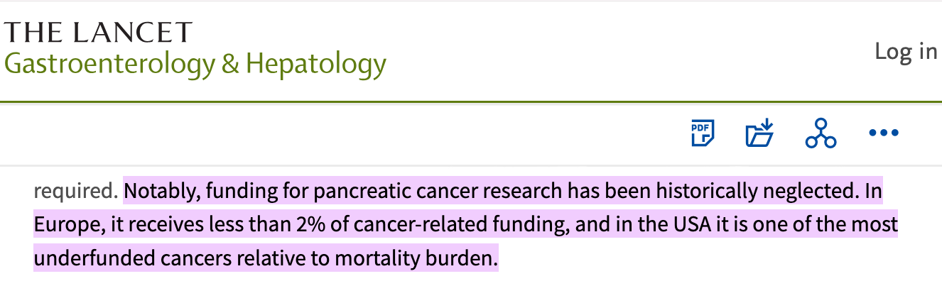
Take global figures for 66,388 awards for cancer research 2016-20:
Pancreas got US$ 834 millions vs Breast at US$ 2.7 billions,
even though it is a far more lethal disease and it’s on the rise.
Recent geopolitical upheavals both in the US and in Europe are threatening potentially life-saving public cancer research funds even further.

Slide 9
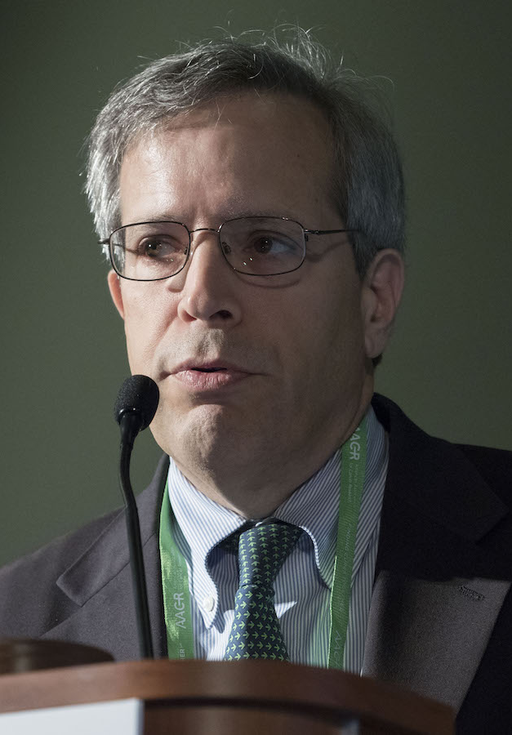
“While our ultimate goal is to prevent and cure cancer, many don’t understand the business aspects behind achieving that goal. […]
Any researcher needs to learn how to work outside of academia
since treatments don’t often get approval
without the involvement
of a very large investment of capital and guidance from venture or private equity firms as well as pharmaceutical companies.”
Prof. Michael A. Caligiuri. MD, FAACR, Past President of the AACR, Department of Hematology & Hematopoietic Cell Transplantation, City of Hope.

Slide 10
Prof. Caligiuri’s talk is not about
financial gains.
It’s about extending our Patients’ lives, which is our only goal.

Slide 11

Second: although TAPCA firmly upholds rigorous patient protections and independent oversight of scientific research, some excessive regulatory constraints do inhibit data flow in PDAC research and slow down progress.
This works against the Patients’ best interest.
With a deadly disease like pancreatic cancer, unimpeded flow of datasets across transnational sites and easing the burden of regulatory compliance are, literally, a life-saving necessity.

Slide 12

Third: how many potentially valuable yet currently untapped resources exist that could substantially strengthen the PDAC ecosystem? At present, this remains unknown.

Slide 13


wants to tackle these issues,
systemically.

Slide 14
In fact TAPCA has a vision.

Slide 15

TAPCA's strategy is to become the prime choice for Life Science & Healthcare Investors as PDAC will dramatically climb the incidence ladder.
Again: for our patients’ sake.
- more below -

Slide 16





All reputable International Health Organizations prognosticate PDAC to become the second leading cause of cancer death by 2030.
Public appeals for treatments will intensify much further.

Slide 17




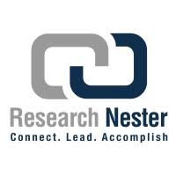









Consensus among all major Investment Consultancies is that the Global Pancreatic Cancer Market Size will grow at an impressive CAGR (Compound Annual Growth Rate) of between 13 and 15% and above, reaching revenues estimated at, or beyond, US$ 10 billions by 2036.

Slide 18
Comparison with Other Cancer Markets
Lung Cancer Market: The lung cancer treatment market is expected to grow at a CAGR of around 9% to 10% over the next few years, which is lower than that of pancreatic cancer.
Breast Cancer Market: The breast cancer treatment market often exhibits a CAGR of about 7% to 8%, which also falls short compared to the pancreatic cancer market's growth rate.
Colorectal Cancer Market: This market is projected to have a CAGR of approximately 8%, again indicating slower growth relative to pancreatic cancer.
Prostate Cancer Market: The prostate cancer treatment market typically sees a CAGR of about 6% to 8%, which is significantly lower than the pancreatic cancer market.
In summary, the pancreatic cancer market's CAGR of 13.3% to 15.8% positions it as one of the fastest-growing segments in oncology, outpacing other major cancer markets such as lung, breast, colorectal, and prostate cancers. The market is driven by increasing incidence rates, advancements in treatment options, and a focus on early detection and precision medicine.

Slide 19
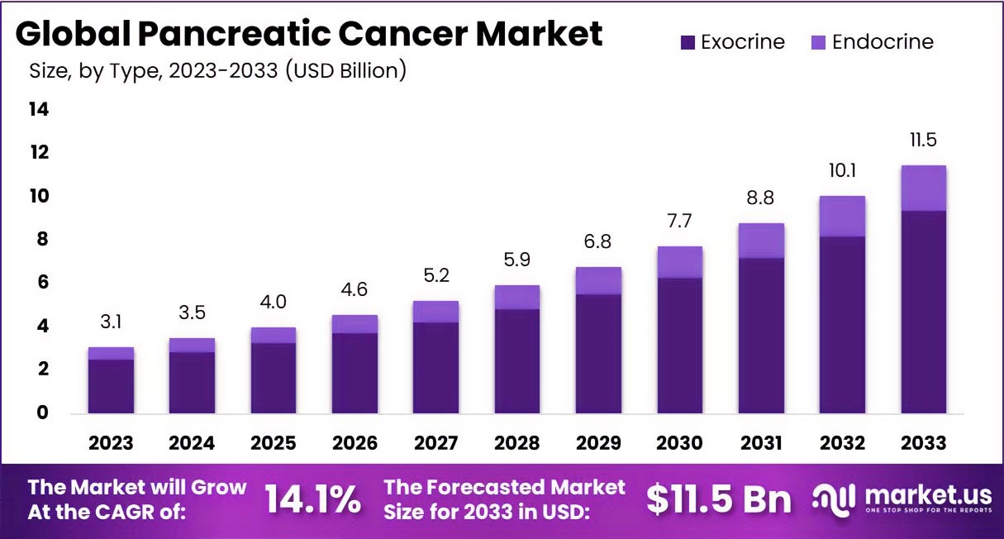
The rationale for this surge of investment in treatments will be:
A) Heavy alcohol consumption, unhealthy diets (and UPF), the rising incidence of obesity, diabetes and longer life expectancy, especially in the 7MM.
B) Breakthroughs in AI driven early diagnostics, advancements in surgery, tumour immunology, personalized genetics and translational research as whole generating an ever expanding pipeline of treatment insights.

Slide 20

As these trends - the alarming rise in PDAC prevalence and the vigorous Market expansion - will combine in the next 12 years,
necessity will be at play.
And not just public clamouring for treatments. Public Funders, the Industry, Life Science and Healthcare Investors are bound to seek opportunities, in fact all reputable Business Consultancies are forecasting it.

Slide 21
TAPCA’s vision
is to anticipate this momentous change.
How?

Slide 22
TAPCA must already be there as
the obvious Go-to place for PDAC investment…
… because it will be the most promising unified
pancreatic cancer treatment hotspot
in the world, armed with the
World’s Largest Patients Registry in PDAC,
a trailblazing tool to bolster our clinical trials

Slide 23
Anticipate necessity
Be the Go-to place for
PDAC investors when it will matter

Slide 24

The D.A.T.A.S.E.T.S. Lobbying Campaign
(Data Availability To All Scientists Enhances Treatment Success)
Fast-tracking the dissemination and use of pancreatic cancer datasets and easing excessive regulatory paperwork for PDAC investigators - while preserving high safety and ethical standards in research - requires a vocal joint effort with Advocacies, Clinicians, Researchers and with the Patients themselves to lobby Policymakers and Regulators.
Join TAPCA in this effort.

Slide 25

Optimising the PDAC ecosystem
(beyond scientific discovery)
The objective is to optimise the PDAC ecosystem in much the same way that Machine Learning/AI have already been successfully applied to improve the efficiency and strategic functioning of large-scale industrial and institutional systems. This means:
Identify systemic inefficiencies, detect hidden negative or positive patterns, reveal underutilised leverage points, discover opportunities for new financial resources, support more effective strategic decisions, and a lot more.
This is in the Patients’ best interest.

Slide 26
TAPCA would be delighted to welcome more colleagues on board and to receive enquiries from Investors, as well as comments and ideas from Patients, General Practitioners and Advocacy Groups.

